Slide 1

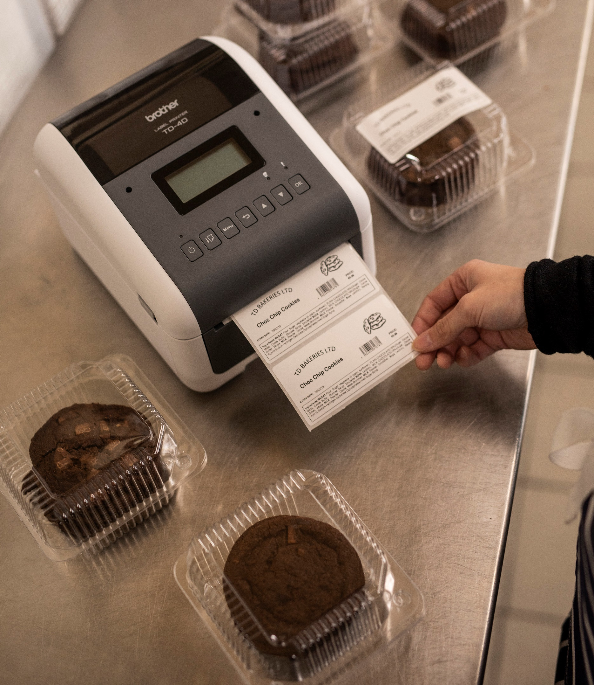
Advanced Specification Sheet
Desktop label, wristband & receipt printers
TD-4210D / TD-4410D / TD-4420DN / TD-4520DN / TD-4550DNWB Data Sheet

Slide 2

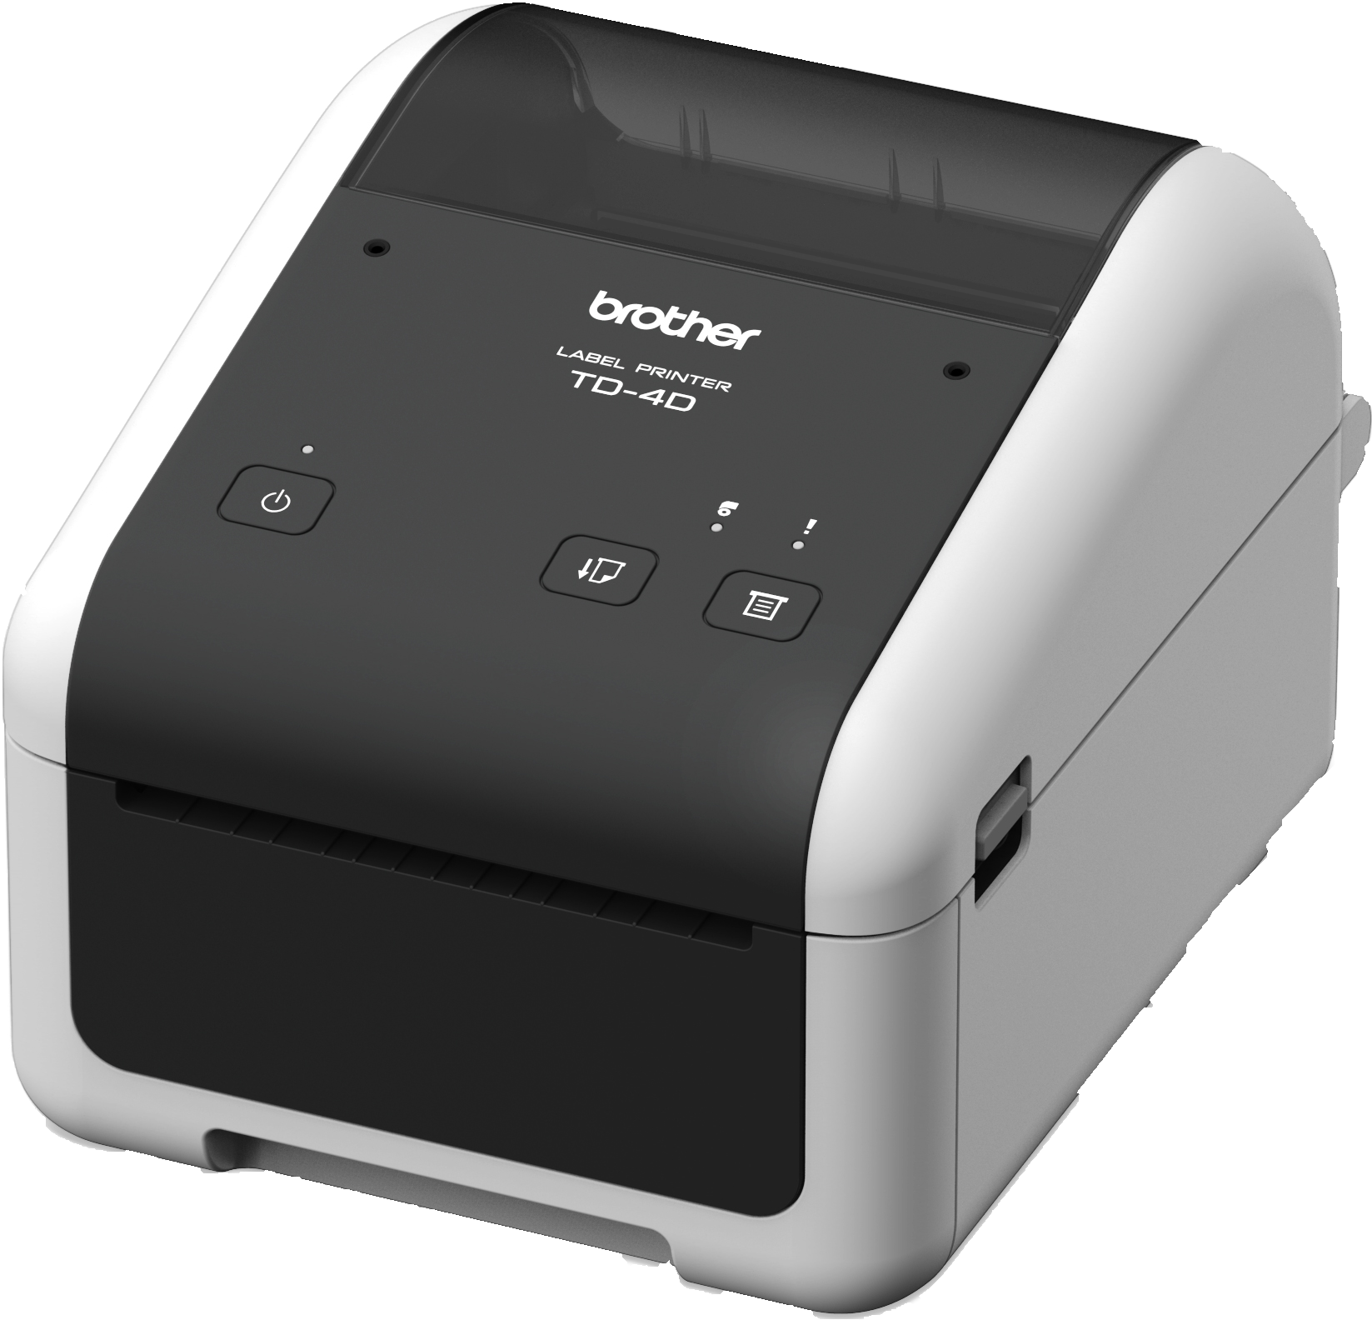
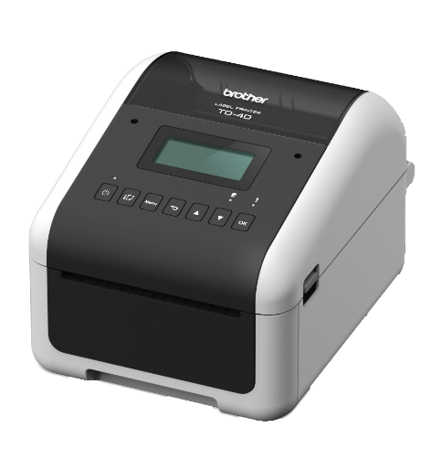
Advanced Specification Sheet
4” Professional direct thermal printer
Brother’s range of TD professional label printers allows you to print high quality labels on demand, whatever the requirement.
Printing labels up to 4 inches in width, using direct thermal print technology, they fit the requirements of a large range of market applications.
Key Features:
Fast print speeds of up to 203mm/sec (8ips)
Direct thermal printing on a range of media
Auto media configuration for easy setup
Ready to integrate with iOS & Android apps
USB, USB Host and Serial connectivity as standard
LCD display with Real Time Clock^
Wide feeding slot with window for oversized media
User replaceable print head and platen roller (optional)
Bluetooth interface (v4.2)^
Peeler or cutter (optional)
Wireless LAN supporting 2.4GHz and 5GHz bands^
TD-4210D / TD-4410D / TD-4420DN / TD-4520DN / TD-4550DNWB | Page 2

Slide 3
General
Carton contents | AC adaptor USB cable Documentation
Language support | Dansk, Deutsch, English, Español, Français, Italian, Nederlands, Norsk, Português, Suomi, Svenska
Software | P-touch Editor: barcode label design software Mobile Deploy App: remote printer configuration^ Brother Font Manager: font download tool (Windows® only via USB) Printer Settings Tool: device configuration software (Windows® only via USB)
Printer commands | Raster, ESC/P, P-touch Template, ZPL2, EPL2, DPL & CPCL emulations (for additional command support contact your local Brother office)
Internal fonts & sizes | <ESC/P> Bitmap font: LetterGothicBold (16,24,32,48dot), Helsinki (16,24,32,48dot), Brussels (24,32,48dot), Brougham (24,32,48dot), San Diego (24,32,48dot), Gothic (16,24,32dot) Outline font: LetterGothic, Helsinki, Brussels, Gothic (1 – 400dots) <P-touch Template> Outline font: LetterGothic, Helsinki, Brussels, Gothic (1 – 400dots) Downloadable font support* via Font Manager software
Internal Barcode | Linear: CODE 39, ITF(I-2/5), EAN-8(JAN8), EAN-13(JAN13), UPC-A, UPC-E, CODABAR (NW-7), CODE 128, GS1-128(UCC/EAN 128), GS1 Databar（Standard（Omnidirectional/Truncated/Stacked/Stacked Omnidirectional/Limited/Expanded）, CODE93, POSTNET, UPC/EAN EXTENSION, MSI, Intelligent Mail Barcode 2-dimensional: QR Code (model 1, model 2, micro QR), Maxicode, PDF417 (Standard, Truncate, MicroPDF417) Data Matrix (ECC200 Square, ECC200 Rectangular), Aztec
Dimensions & Weights
Without carton | 180(w) x 155(d) x 224(h) | 2.08Kg
Built In Features
Printing Method | Direct Thermal
Minimum print length | Continuous: 6.4mm, Peeler: 17mm, Cutter: 20mm, Tear: 18mm
Maximum print length | 3000mm
Minimum media width | 19mm
Maximum media width | 118mm
Maximum roll diameter | 127mm
Minimum roll core diameter | 12.7mm
Interfaces | USB Ver.2.0 (Full Speed) (Type B) USB Host^ Serial RS232C (DB9 male) Bluetooth Version.4.2 /MFi / SPP, OPP, HCRP (Bluetooth Classic), GATT (Bluetooth Low Energy)^ Wireless LAN 802.11a/b/g/n supporting 2.4GHz & 5GHz (supporting AirPrint® from iOS® devices)^ Wired LAN 10/100BASE-TX^^
Operating system support | Microsoft® Windows® 7 / Windows® 8 / Windows® 8.1 / Windows® 10 / Windows® 11 Microsoft® Windows® Server 2008 / Server 2008R2 / Server 2012 / Server 2012R2 / Server 2016 / Server 2019 (TD-4420DN, TD-4520DN, TD-45550DNWB) Linux
Mobile OS Support | Android 4.0.3 or later iOS® 8 or later (TD-4420DN, TD-4520DN, TD-45550DNWB) Requires 3rd party app development using Brother SDK, further information available at https://support.brother.com/g/s/es/dev/en/index.html
Environmental
Operating Temperature | 5ºC to 40ºC
Operating Humidity | 20% to 85% non-condensing
Storage Temperature | -20ºC to 60º C
Storage Humidity | 10% to 90% non-condensing
TD-4210D / TD-4410D / TD-4420DN / TD-4520DN / TD-4550DNWB | Page 3

Slide 4
Supplies
Receipts | BDL-7J000102-058: 101.6mm x 32.2m BDL-7J000076-066: 76mm x 42m BDL-7J000058-102: 58mm x 101.6m BDL-7J000058-040: 58mm x 13.8m
Labels | BDE-1J152102-058: 85 labels - 102mm x 152mm BDE-1J000102-102: Continuous labels - 102mm x 58m BDE-1J050102-102: 1,050 labels - 102mm x 50mm BDE-1J152102-102: 350 labels - 102mm x 152mm BDE-1J026076-102: 1,900 labels - 76mm x 26mm BDE-1J044076-066: 400 Labels - 76mm x 44mm BDE-1J026051-102: 1,900 labels - 51mm x 26mm BDE-1J026051-060: 500 Labels - 51mm x 26mm
Optional Accessories (User Option)
Label Peeler | PA-LP-002
Cutter | PA-CU-001
Thermal print head | 203dpi: PA-HU2-001 300dpi: PA-HU3-001
Platen Roller | 203dpi: PA-PR2-001 300dpi: PA-PR3-001
^TD-4550DNWB only
^^TD-4420DN/TD-4520DN/TD-4550DNWB only
*Font Licensee permissions are required
Model Comparison
 | TD-4210D | TD-4410D | TD-4420DN | TD-4520DN | TD-4550DNWB
Maximum print width | 104mm | 104mm | 104mm | 108mm | 108mm
Print resolution | 203dpi | 203dpi | 203dpi | 300dpi | 300dpi
Printing speed | 5ips (127mm/sec) | 8ips (203mm/sec) | 8ips (203mm/sec) | 6ips (152mm/sec) | 6ips (152mm/sec)
USB / USB Host | Yes / No | Yes / No | Yes / No | Yes / No | Yes / Yes
Serial | Yes | Yes | Yes | Yes | Yes
Wired LAN | - | - | Yes | Yes | Yes
Bluetooth | - | - | - | - | Yes
Wi-Fi | - | - | - | - | Yes
LCD (incl. Real Time Clock) | - | - | - | - | Yes
All specifications are correct at the time of printing and are subject to change without notice. Brother and the brother logo are both trademarks of Brother Industries, Ltd., registered in Japan and certain other countries. Any trade names, logos and product names of other companies appearing are trade names or trademarks of those respective companies.
BIE Product Planning: Last updated 08/02/2022
TD-4210D / TD-4410D / TD-4420DN / TD-4520DN / TD-4550DNWB | Page 4

